Slide 1
History of GNU/Linux Operating System
Name: Pradyoth Singenahalli Prabhu
Course: High-Performance Scientific Computing

Slide 2
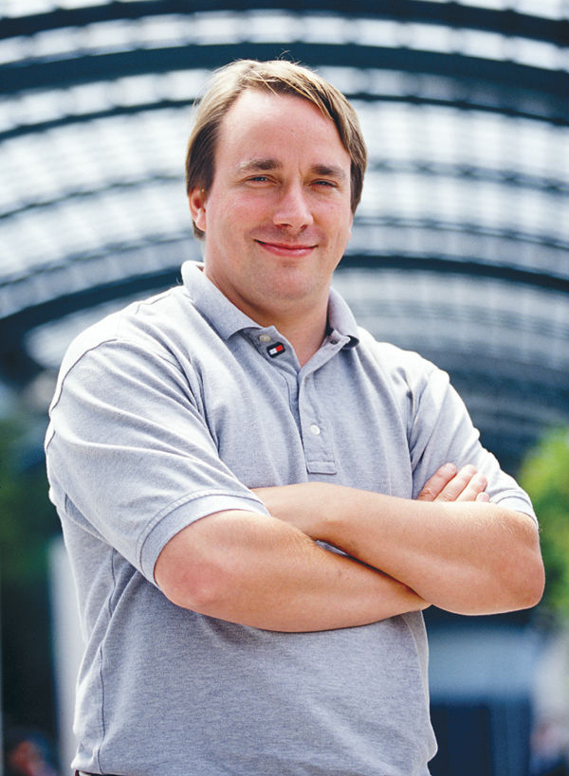
Creation
Linus Torvalds started a project that would ultimately become Linux in 1991 while he was a computer science student at the University of Helsinki, Finland.
He wanted to create a better alternative for MINIX, as it was only time limited to educational purposes only.

Slide 3
Why?
MS-DOS was popular but needed license.
Apple Macintosh was expensive.
Unix was also expensive.

Slide 4
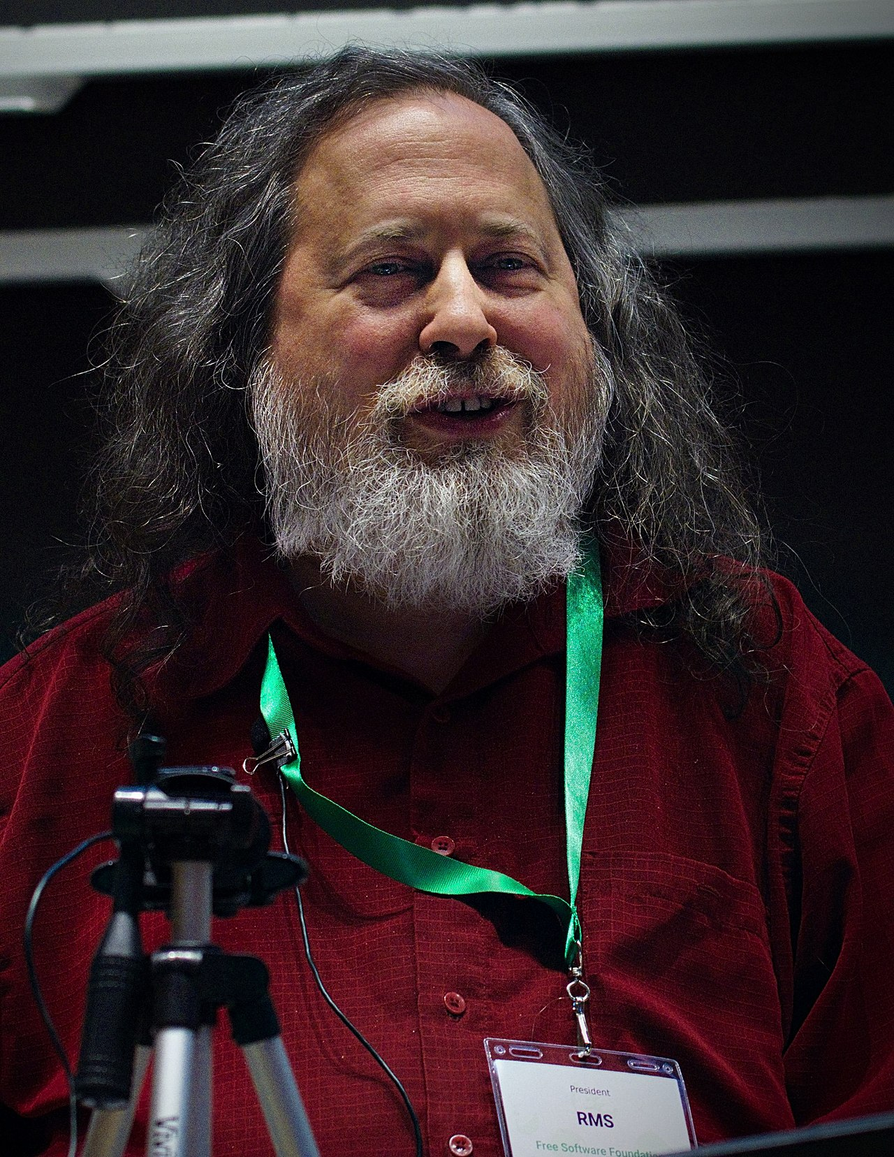
Foundation/GNU
The GNU General Public License (GNU GPL), a Free Software license, was created by Richard Stallman.
Linus developed the Linux kernel using the foundation laid by Richard Stallman’s work on the GNU project.

Slide 5
Naming
Linus wanted to call his invention Freax, a mix of ‘free’, ‘freak’, and ‘x’.
In order to facilitate development, the files were uploaded to the FTP server. During this, his co-worker changed the name to “Linux ” without the knowledge of Linus.
To help people pronounce "Linux," Linus also supplied an audio pronunciation tutorial with the kernel source code.

Slide 6

Official Mascot
Torvalds announced in 1996 that there would be a mascot for Linux, a penguin.
This was because when they were about to select the mascot, Torvalds mentioned he was bitten by a little penguin on a visit to the National Zoo & Aquarium in Canberra, Australia.
It’s called TUX.

Slide 7
Versions
Currently it is in v6.0
v1.0 in 1994
v2.0 in 1996
v3.0 in 2011
v4.0 in 2015
V5.0 in 2019
Notes:
Film production according to Linux Movies Group

Slide 8
Current Development
Greg Kroah-Hartman, is the lead maintainer of Linux kernel and guides its development.
William John Sullivan is the executive director of the free software foundation, which in turns supports the GNU components.

Slide 9
Linux distributions
Ubuntu
Debian
CentOS
Red Hat Enterprise Linux
Gentoo
Fedora
ElementaryOS

Slide 10
Usage of linux
Desktops and laptops: 2.5%
Web servers: 96.55%
Mobile devices: 71.9%
Film production: >95%
Use in government
Notes:
Film production according to Linux Movies Group

Slide 11
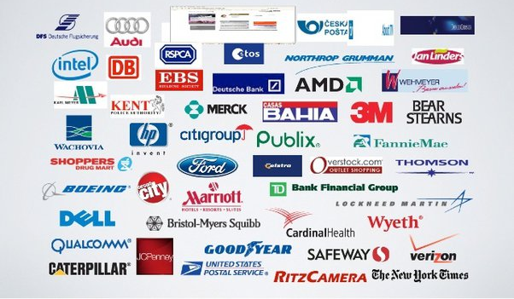
Companies using Linux
Notes:
Film production according to Linux Movies Group

Slide 12
Thank you

